Slide 1
Communicating Cyber Risk to the Board
Metricon X
Wade Baker

Slide 3
A funny aside…

Slide 6
…enough of that.

Slide 8
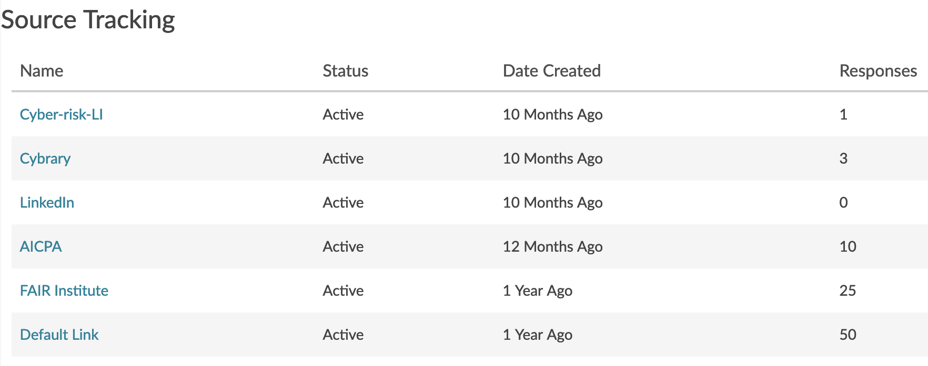

Slide 9
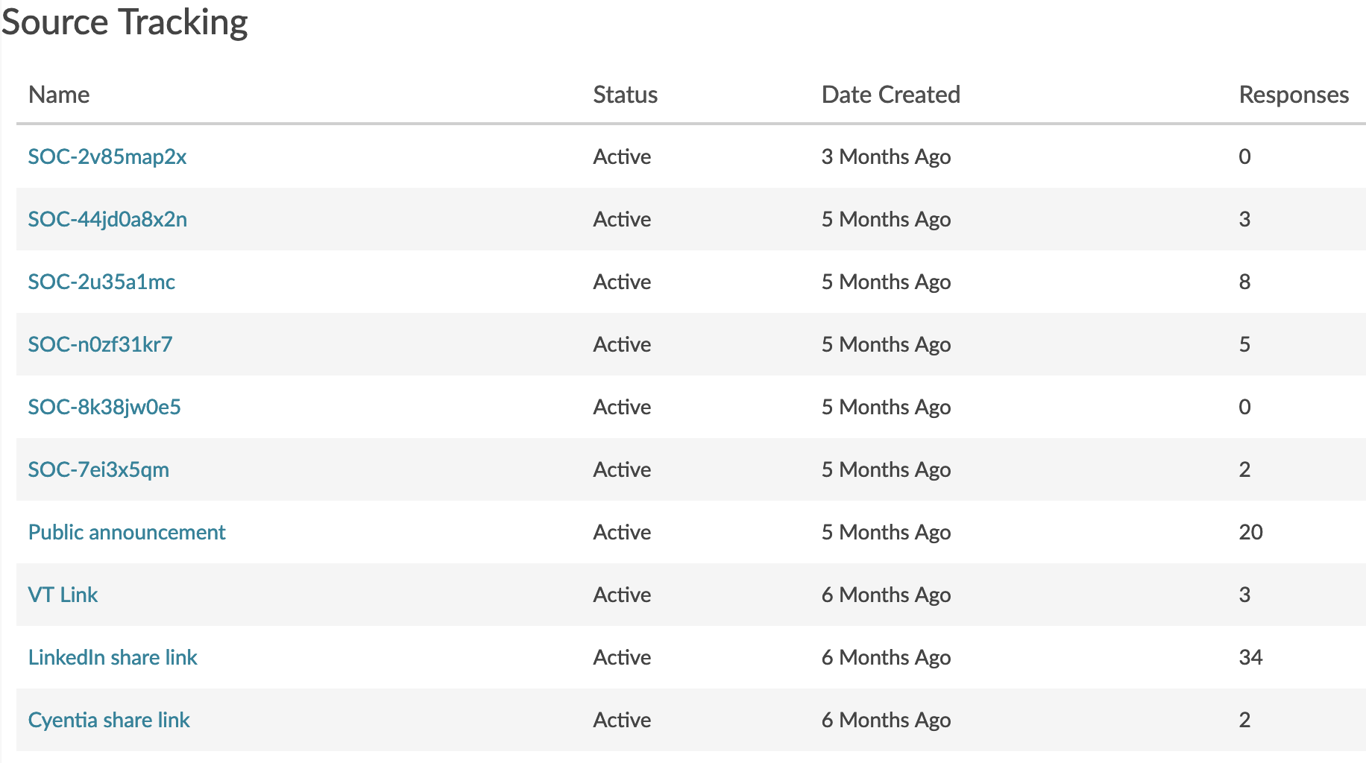

Slide 10
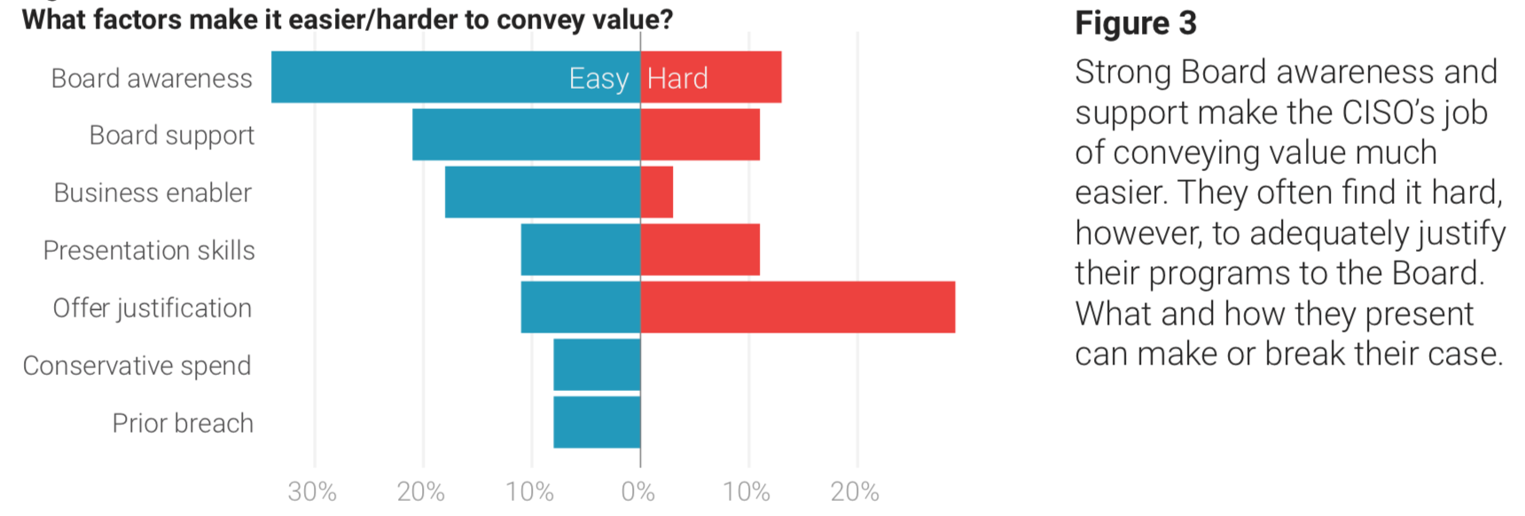
Review of 2017 Study

Slide 11
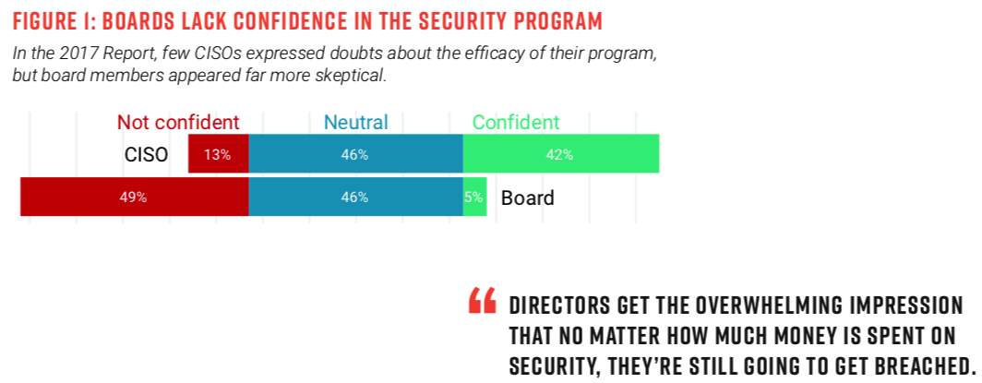
Review of 2017 Study

Slide 12
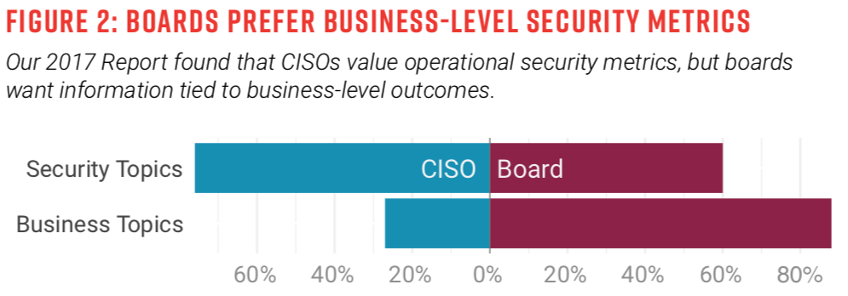
Review of 2017 Study
When asked what information they find most valuable for understanding the cybersecurity posture of the company, boards crave far more business-relevant reporting than CISOs.

Slide 13
2018 Research Questions
How is cyber risk perceived relative to other types of risk? What factors alter this perception?
What cyber risk information is reported to the board? What drives dialogue and value?
How is cyber reporting viewed by the board? What drives confidence and satisfaction?
How does cyber risk reporting — and reception — vary across roles and organizations?

Slide 14
Risk Drivers

Slide 15
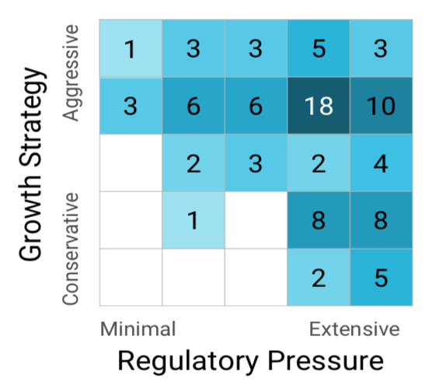
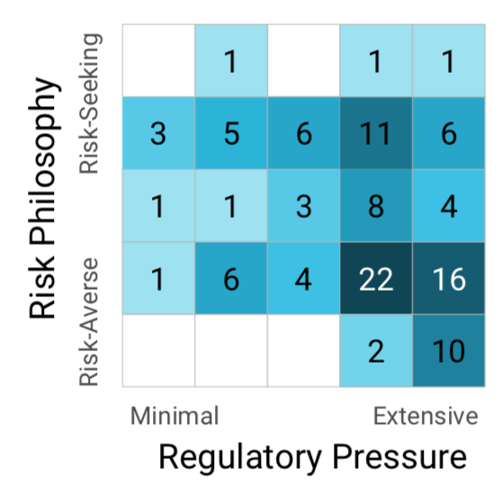
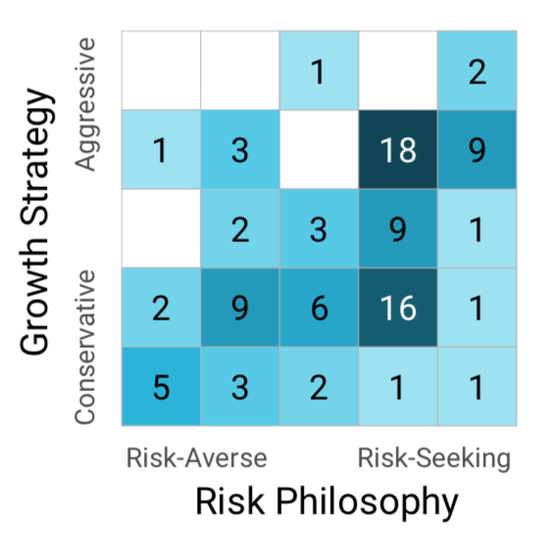
Risk Drivers

Slide 16
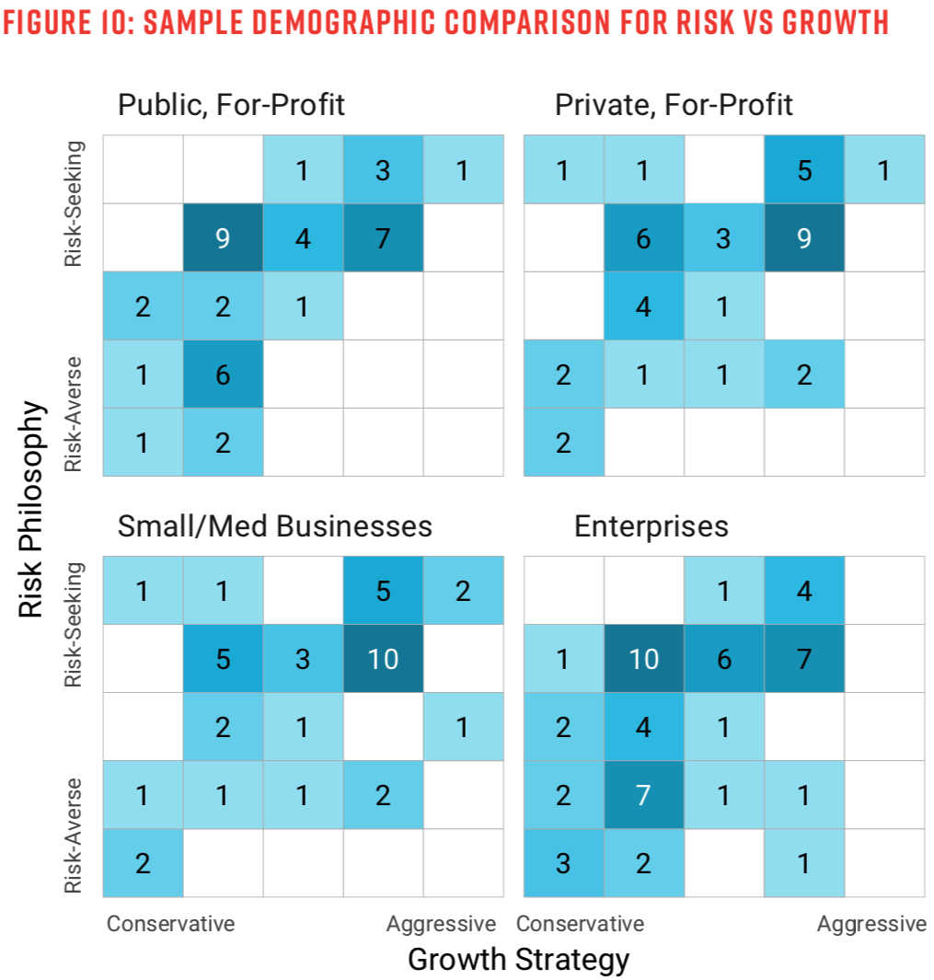
Risk Drivers

Slide 17
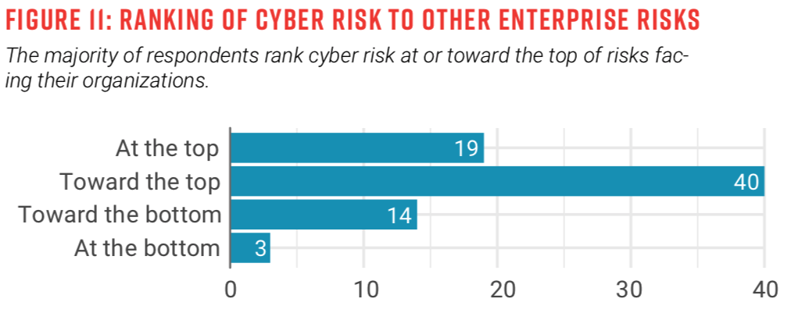
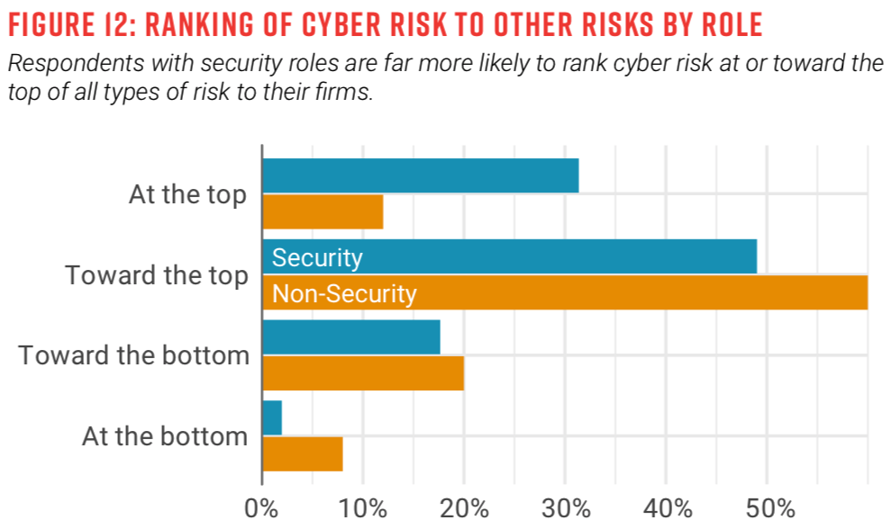
Cyber Risk in Perspective

Slide 18
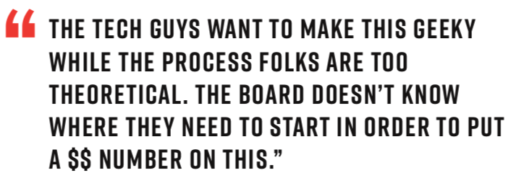
Expressing Cyber Risk

Slide 19
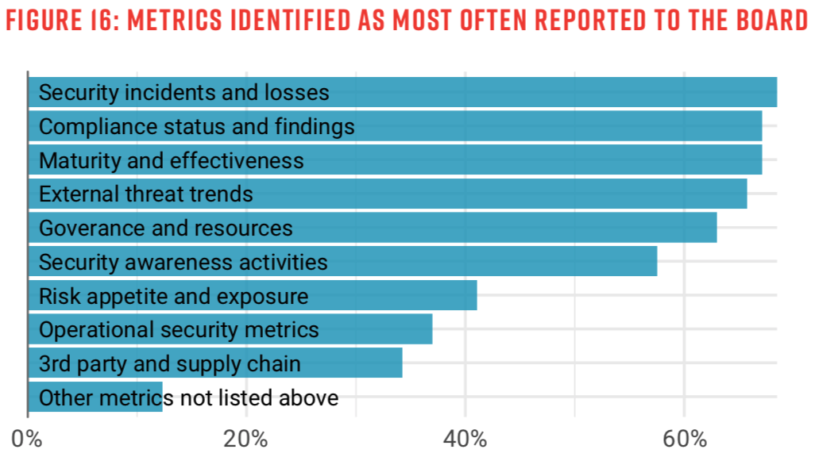
Board Reporting

Slide 20
Board Reporting

Slide 21
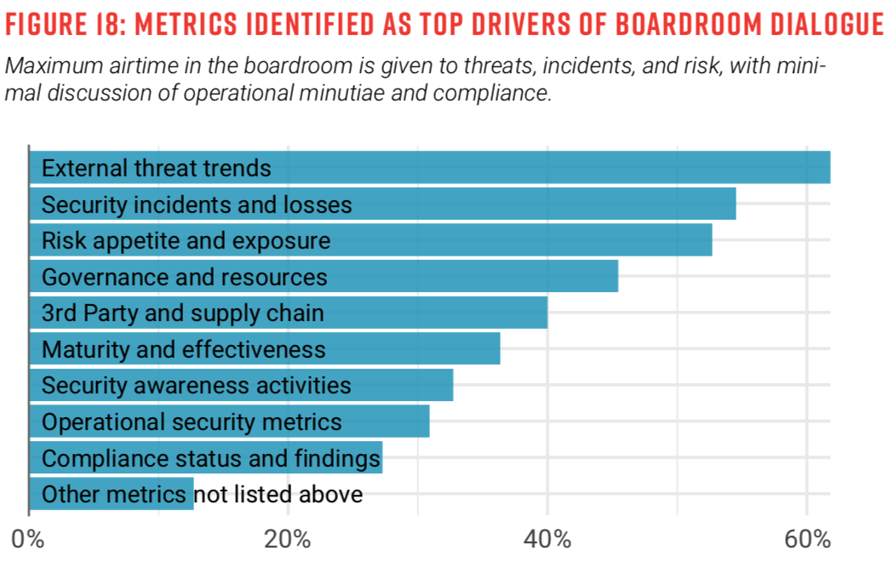
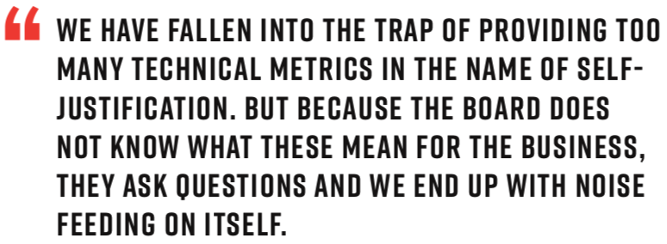
Boardroom Dialogue

Slide 22
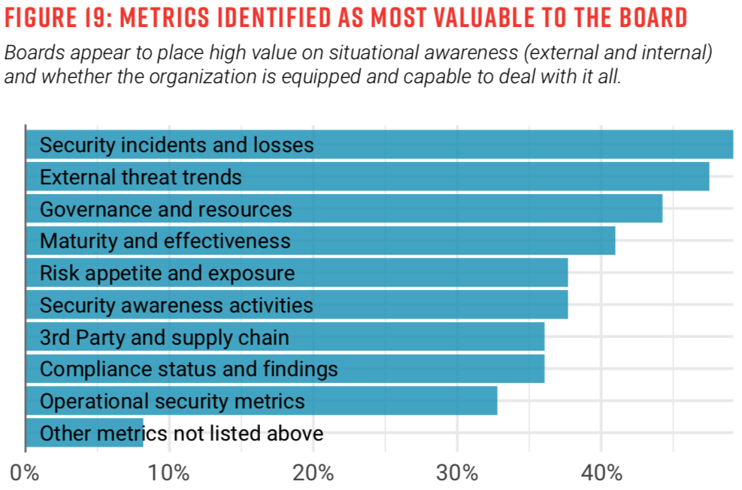
Value to Board

Slide 23
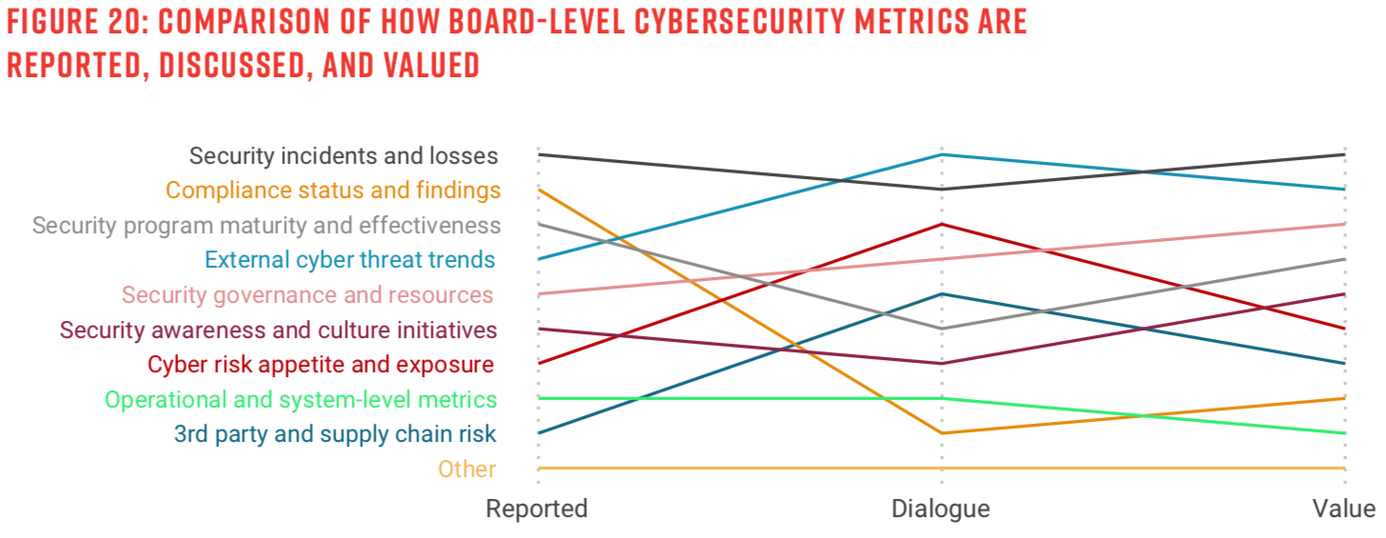
Metrics Reporting

Slide 24
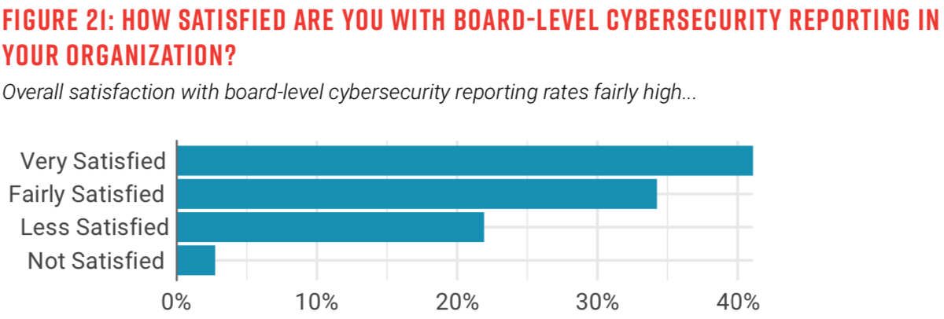
Metrics Reception

Slide 25
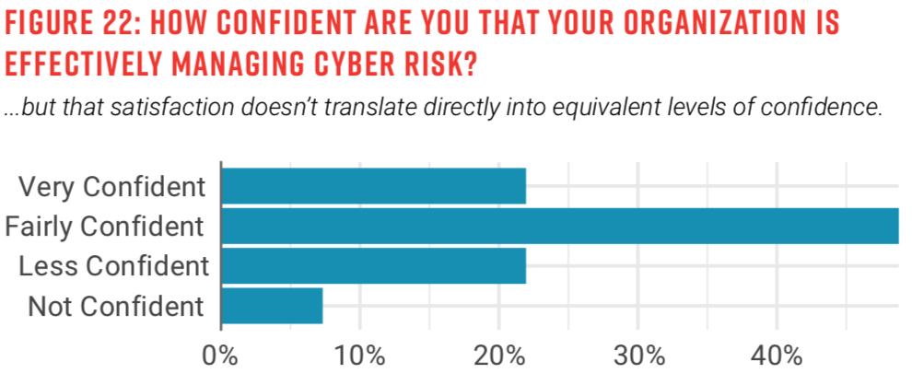
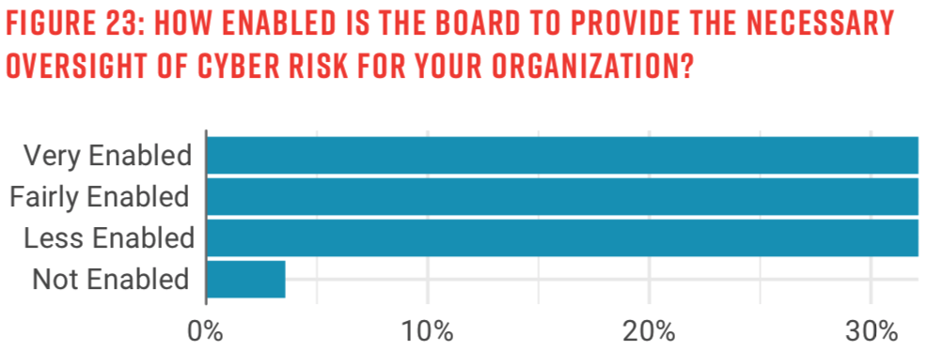
Metrics Reception

Slide 26
Metrics Reception

Slide 27
Conclusion

Slide 28
Conclusion

Slide 29
Conclusion

Slide 30
Conclusion

Slide 31
Conclusion

Slide 32
Questions?
Thank you!

